Slide 1
SQL INJECTION
Presented by –
Sanidhya Gupta (2021ucp1258) Mihika Singh (2021ucp1251)

Slide 2
Objective
To make a login page where the user can enter the email and the password, and the details of which all the users are there are stored in the database through the SQL.
To restrict the user from entering the webpage if the email or the password not matches with that in the database.
To write a SQL query through which the attacker can attack the system and is able to login without the use of the password.
To make a system that is attacker proof by changing the SQL query to make it less vulnerable to attacks.

Slide 3
Aim
To make a working interface to execute the objectives of the project.
To develop a secure login system.
Exploring SQL injection vulnerabilities.
Enhancing security measures.
Implementing authentication mechanisms.

Slide 4
Learning
Got to learn about the flask library in the python, through which the connection to the database can be made easily.
Got to learn about the sql3lite library in the python to make the database and establish the connection with it.
Got to learn about the setting of the UI of the webpage thorugh the use of the html.
Got to learn about the GET and the POST requests that are made between the server and the client in the process.
Got to establish a secure way of protecting the user’s credentials.

Slide 5
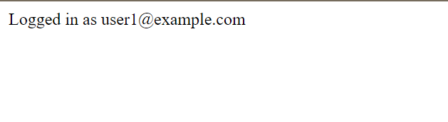
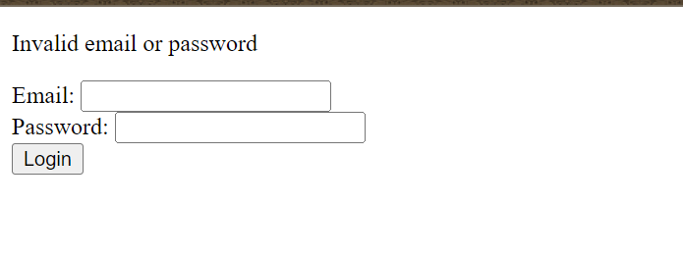
Outcome – (with safe query)

Slide 6
Outcome – (with attack vulnerable query)

